Slide 1
Analog Scaling Instructions
SIEMENS
© 2015 John Sefcovic

Slide 2
SCALING
Scaling using program instructions:
The Analog Modules do not provide scaling in the modules.
The data may be transferred over a network as raw binary data and will need to be scaled.
Scaling can be done in these languages using these instructions:
Ladder Logic:.
Function Block:
Structure Text:
CALCULATE (Compute Expression)
- and/or -
NORM_X (Normalize) SCALE_X (Scale)
Alarming is done us by using Comparator operations and other logic.

Slide 3
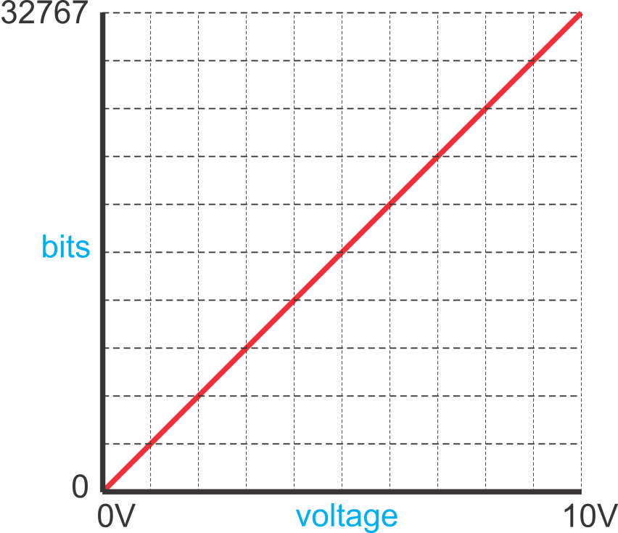
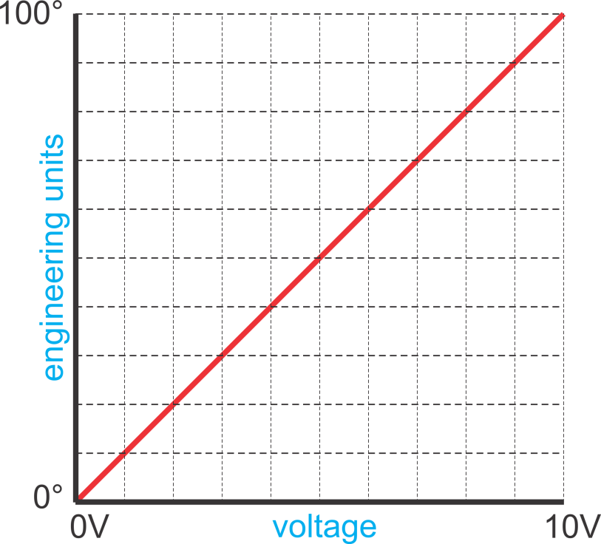
SCALING
For analog inputs and outputs, scaling is defining a ratio of the engineering units, the value range being measured, and the bit values produced by the electrical signal.

Slide 4
SCALING CALCULATIONS
bit min or max: minimum or maximum bit value of the module
scaled min or max: minimum or maximum value in engineering units, i.e. 0 psi. to 500 psi
scaled value: value in engineering units to determined from bit value
bit value: binary equivalent of scaled value
ANALOG INPUT (Bit value to Scaled Value)
Scaled value = (bit value x slope) + offset
Slope = (scaled max. – scaled min.) / (bit max. – bit min.)
Offset = scaled min. – (bit min. x slope)
ANALOG OUTPUT (Scaled value to Bit value)
Bit value = (scale value x slope) + offset
Slope = (bit max. – bit min.) / (scaled max. – scaled min.)
Offset = bit min. – (scaled min. x slope)

Slide 5



SCALING DATA
The analog modules use a 15 bit, signed integer (32767 to -32,767), for the change in voltage or current.
Full Range is not used to represent the change in voltage or current, only the Rated Range.
Overflow Range
32767
Overshoot Range
32511
27684
Rated Range
-27684
Undershoot Range
-32511
Underflow Range
-32767
NOTE: Bit range dependent on Analog Module type.

Slide 6
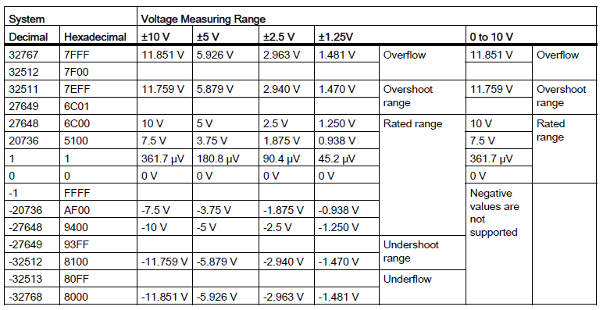
SCALING DATA
NOTE: Table dependent on Analog Module type.
Analog Input Table

Slide 7
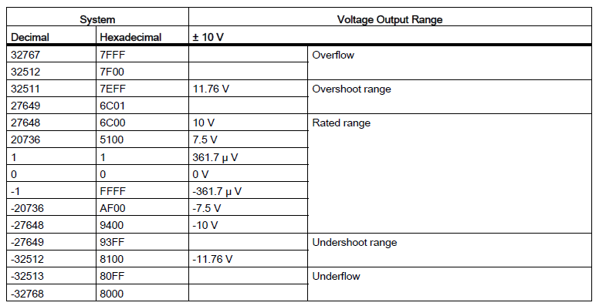
SCALING DATA
NOTE: Table dependent on Analog Module type.
Analog Output Table

Slide 8
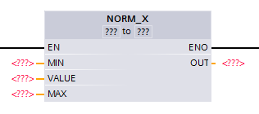
NORM_X INSTRUCTION
Normalize
The NORM_X instruction normalize a VALUE by mapping it to a linear scale based on the MIN and MAX parameters to define the limits of a value range applied to the scale.
The result is calculated and saved as a floating-point number.
If the value to be normalized equals the value at input MIN, the instruction returns the result "0.0".
If the value to be normalized equals to the value at input MAX,
the instruction returns the result "1.0".

Slide 9
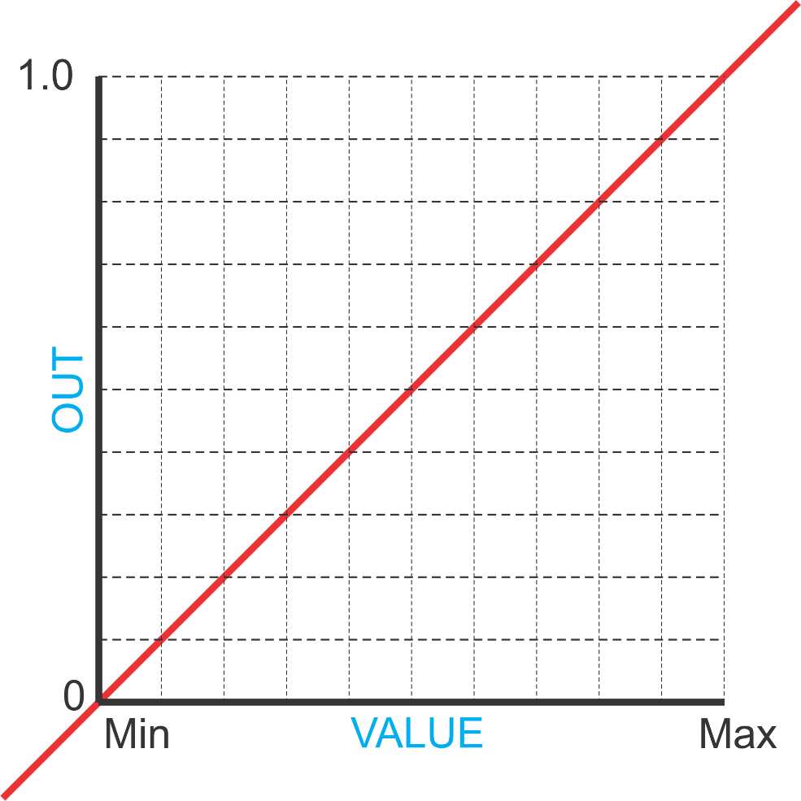
NORM_X INSTRUCTION
A linear normalization of the VALUE is calculated for the OUT as a Floating Point value.
The In VALUE (Floating Point or Integer) is in the range of the Minimum and Maximum values.

Slide 10
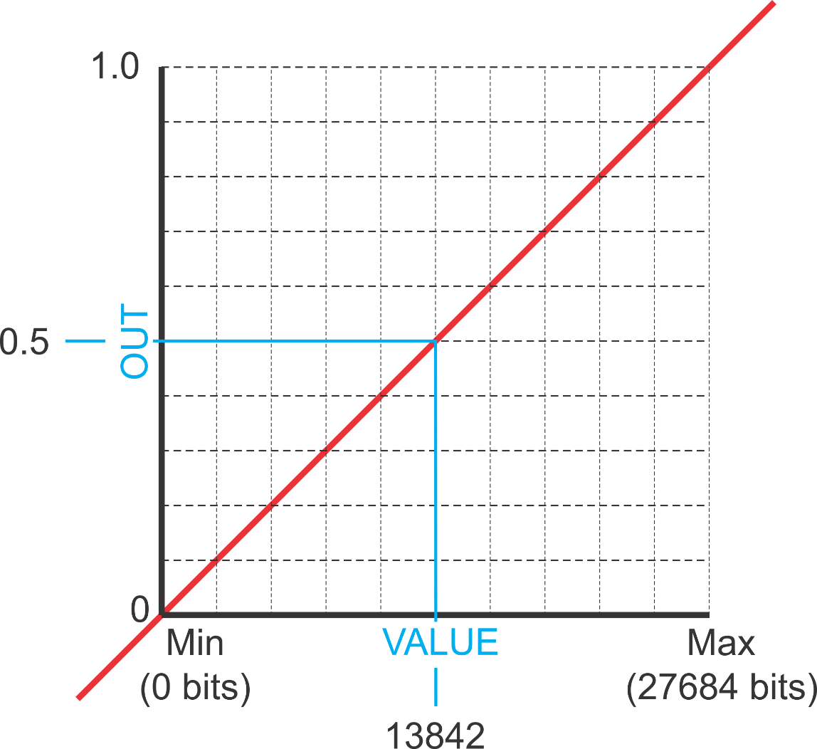
NORM_X INSTRUCTION
… is normalized as a value of 0.5 for the OUT.
In this example, the bit VALUE of 13842…

Slide 11
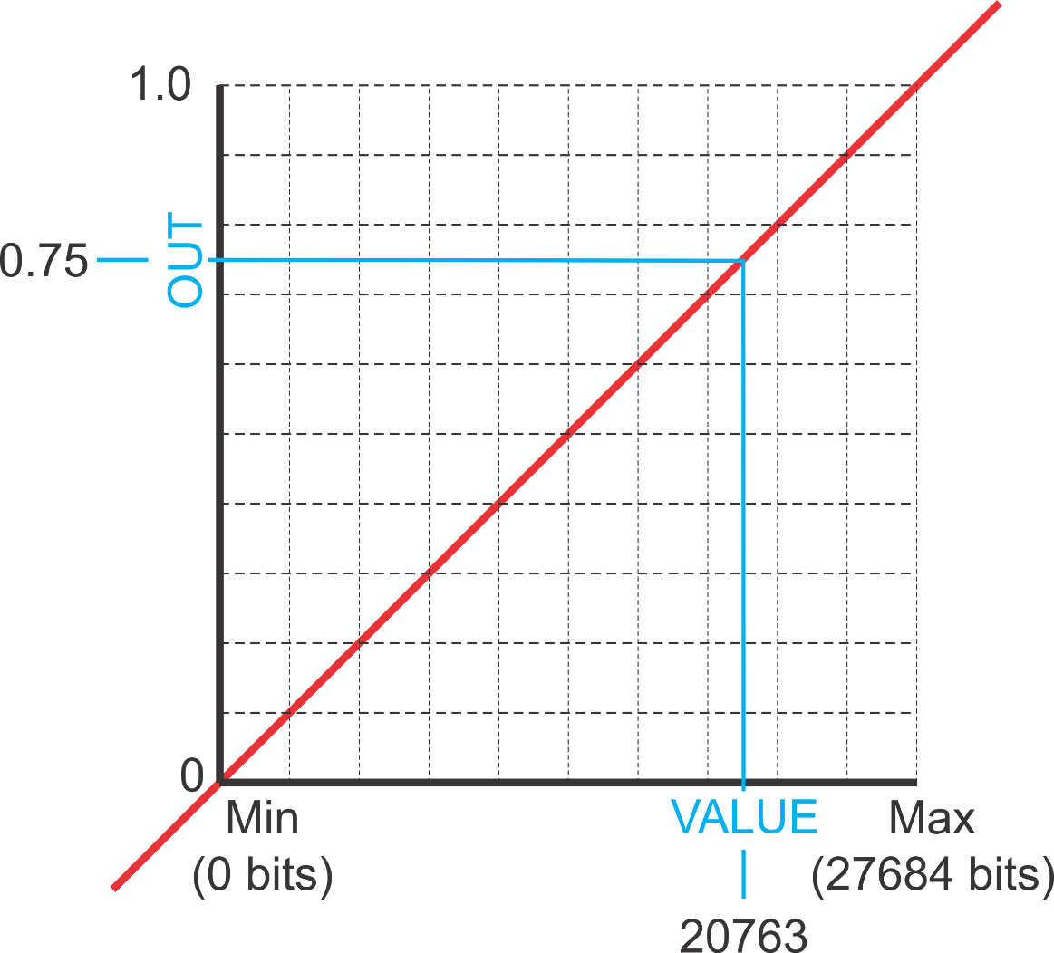
NORM_X INSTRUCTION
… is normalized as a value of 0.75 for the OUT.
A the bit VALUE of 20763…

Slide 12
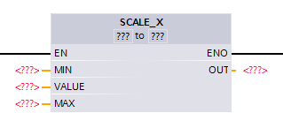
SCALE_X INSTRUCTION
Scale
The SCALE_X instruction scales the value at input VALUE by mapping it to a specified value range in Engineering Units.
When executed, the floating-point value at the VALUE input is scaled to the value range that was defined by the MIN and MAX parameters.
The result of the scaling is stored in the OUT.

Slide 13
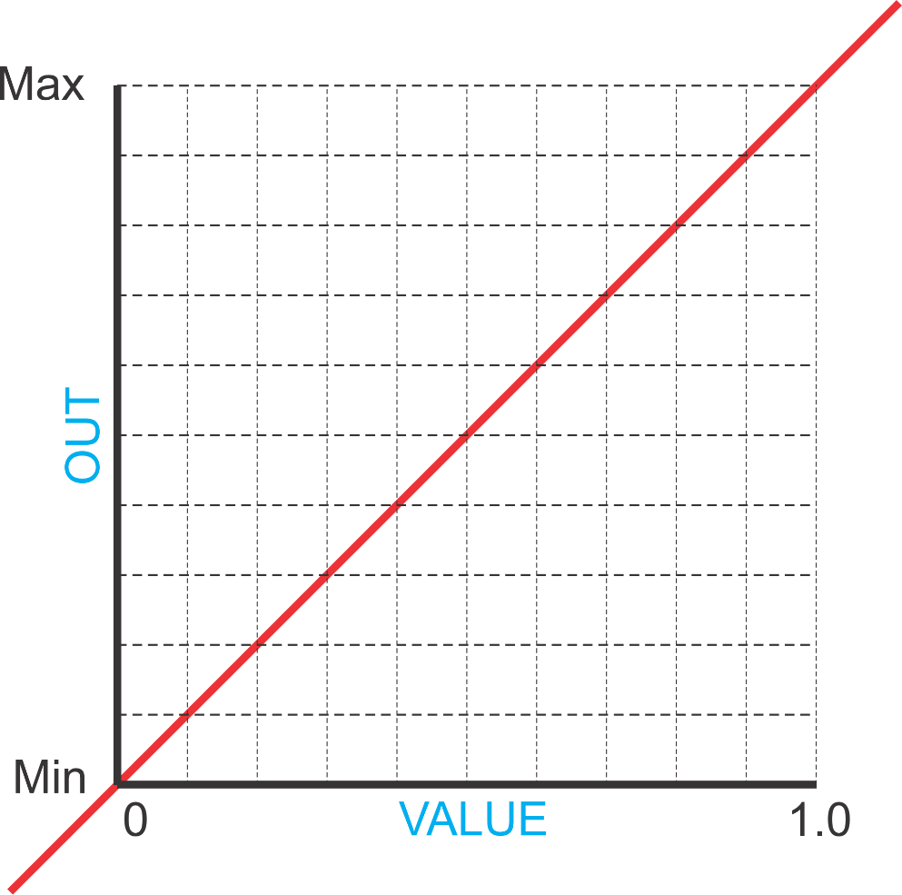
SCALE_X INSTRUCTION
The value is scaled to the Minimum and Maximum values for the OUT as a Floating Point or Integer value.
The In (Floating Point) is in the range of 0 to 1.0 VALUE.

Slide 14
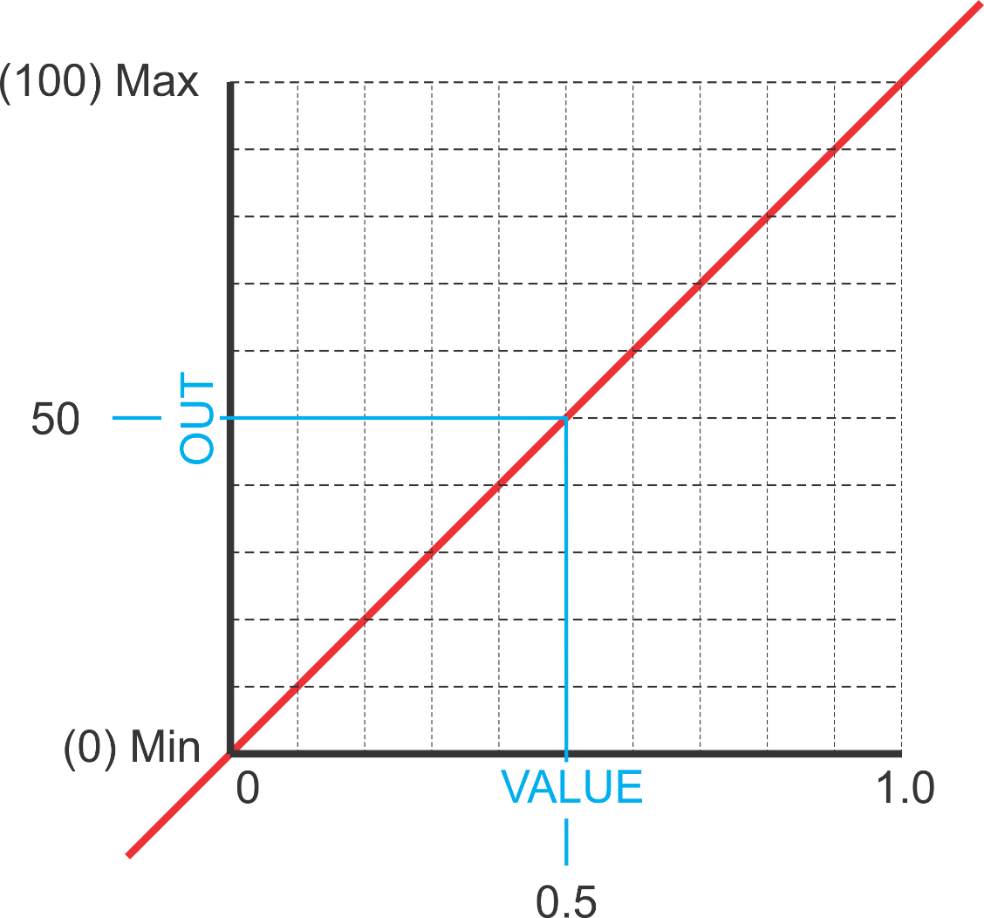
SCALE_X INSTRUCTION
… is scaled to a value of 50 for the OUT.
A floating point VALUE of 0.5…

Slide 15
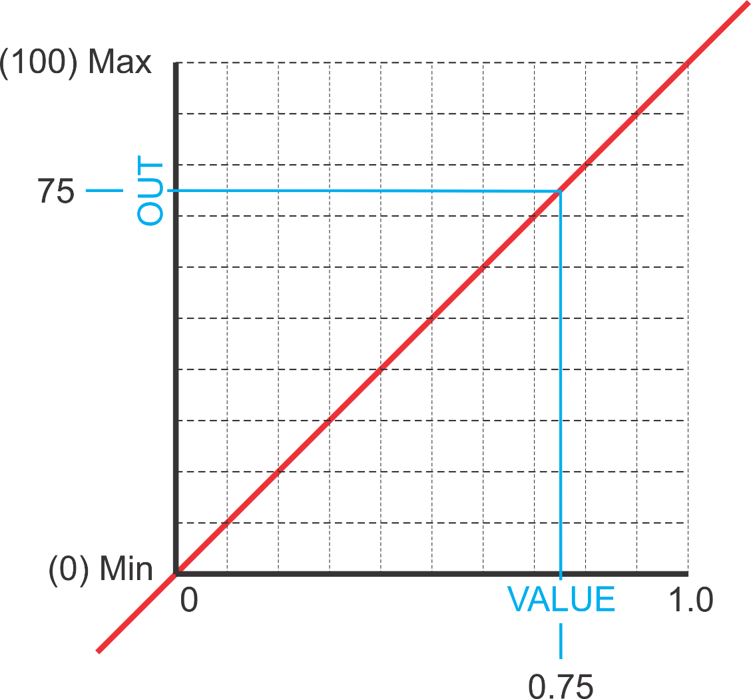
SCALE_X INSTRUCTION
… is scaled to a value of 75 for the OUT.
A floating point VALUE of 0.75…

Slide 16
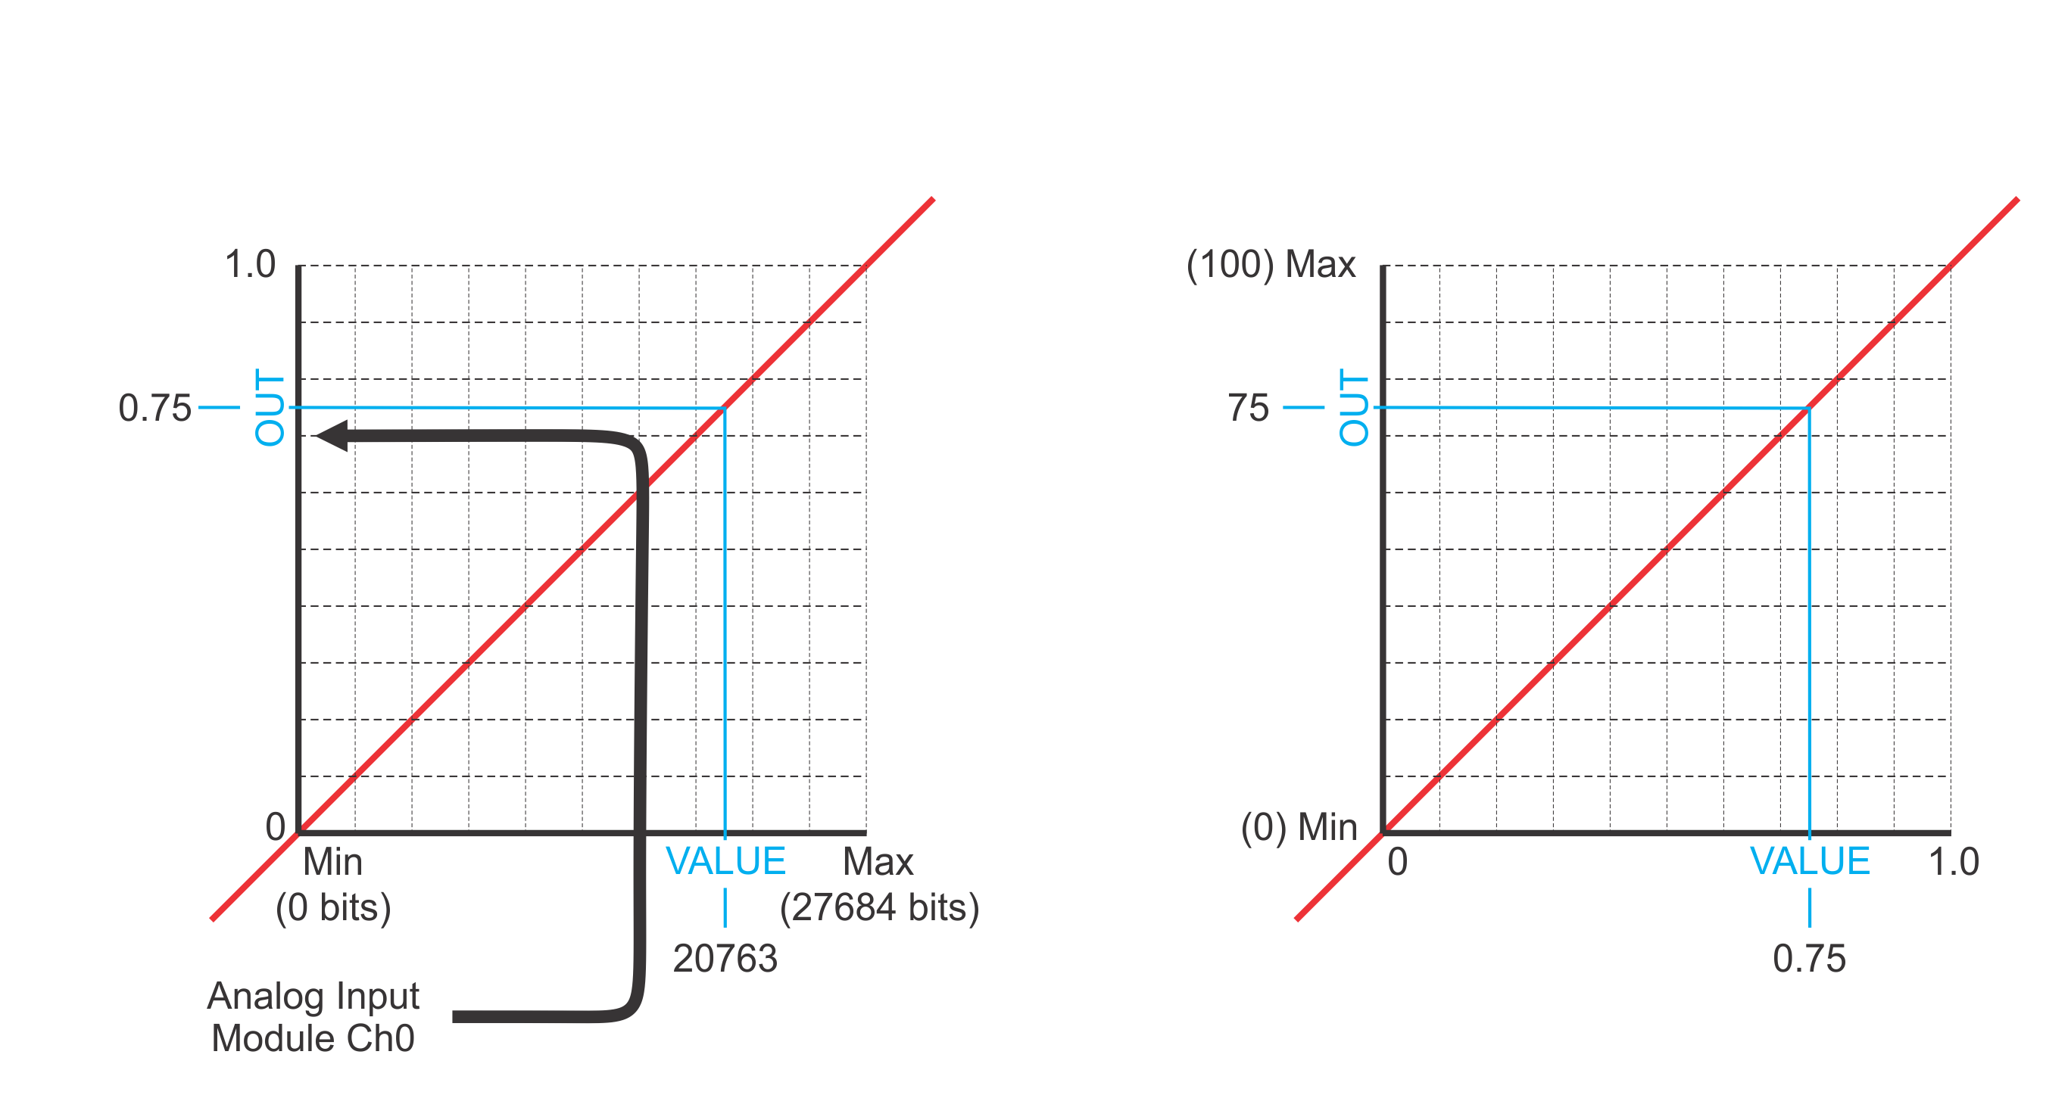
NORM_X and SCALE_X INSTRUCTION
Overview of NORM_X to SCALE_X data flow.
NORM_X
SCALE_X
The Analog Input’s bit value is the In VALUE to the NORM_X instruction

Slide 17
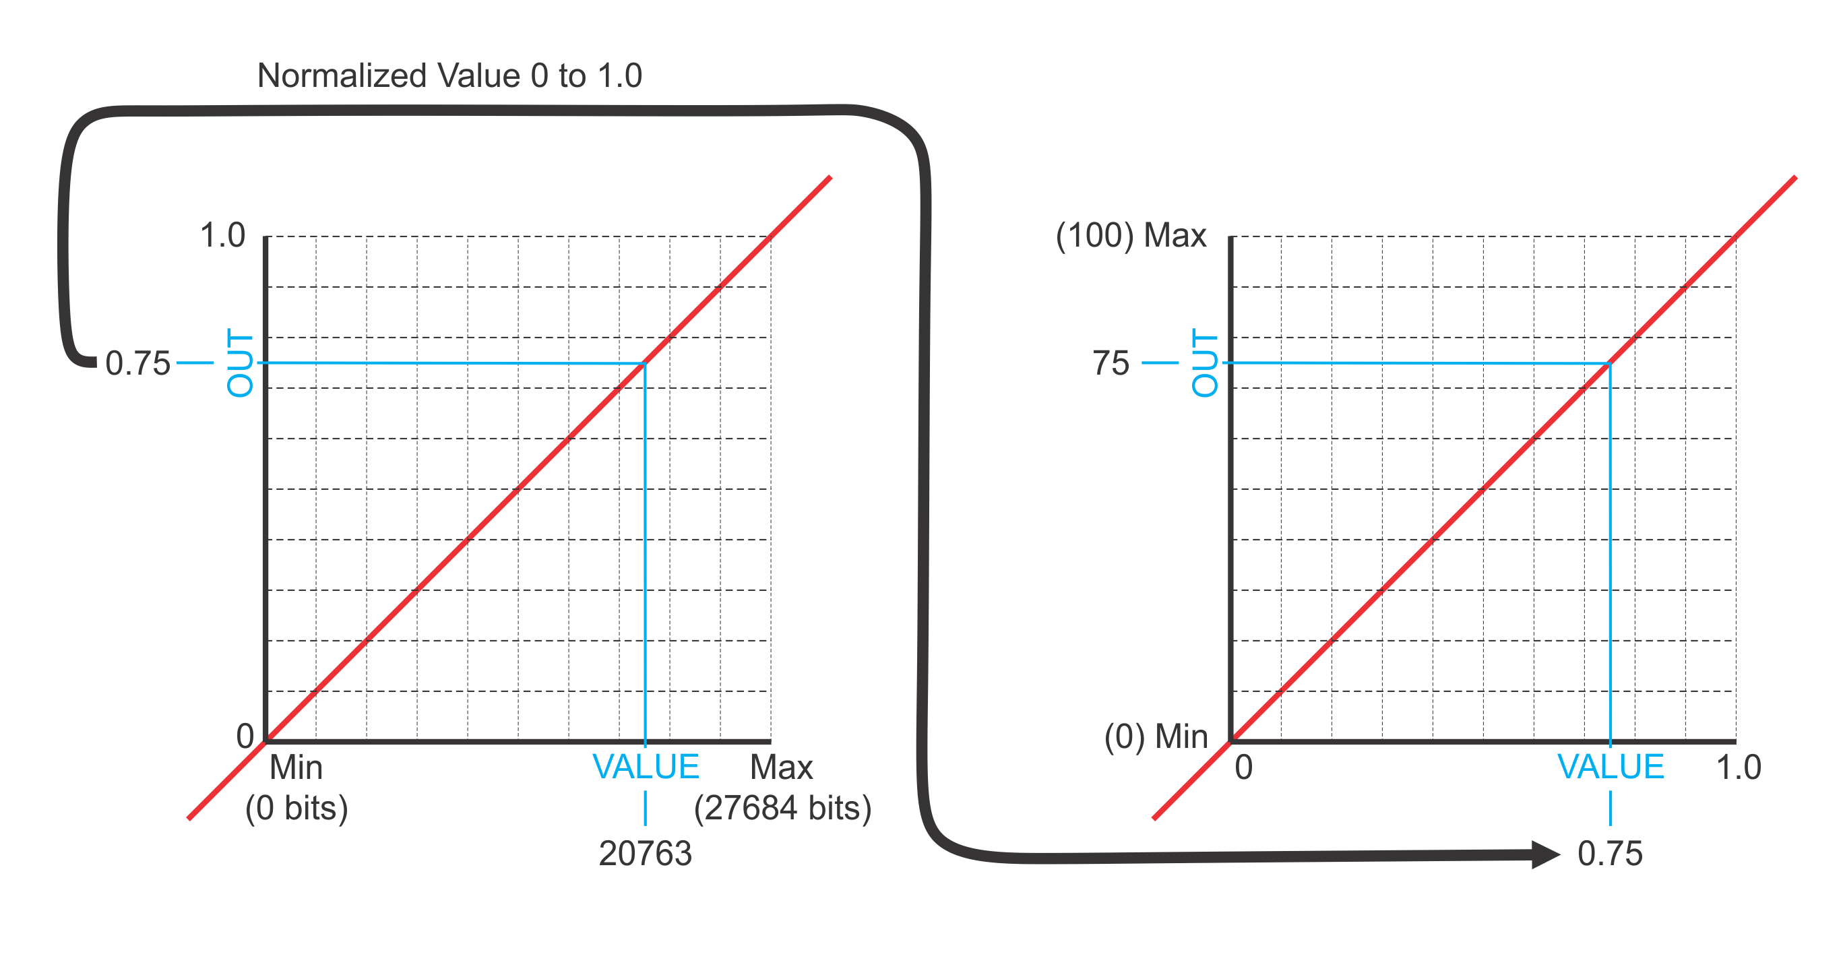
NORM_X and SCALE_X INSTRUCTION
NORM_X
SCALE_X
The normalized
OUT…
…is the In VALUE for the SCALE_X instruction.

Slide 18
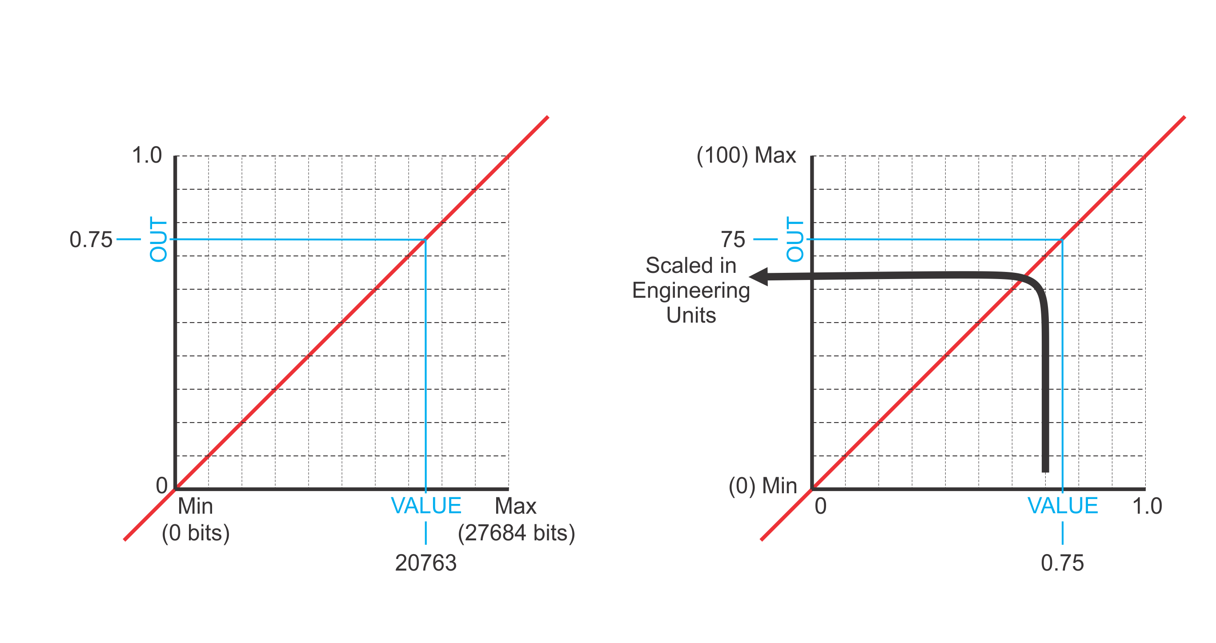
NORM_X and SCALE_X INSTRUCTION
NORM_X
SCALE_X
The VALUE results in a scaled OUT.

Slide 19
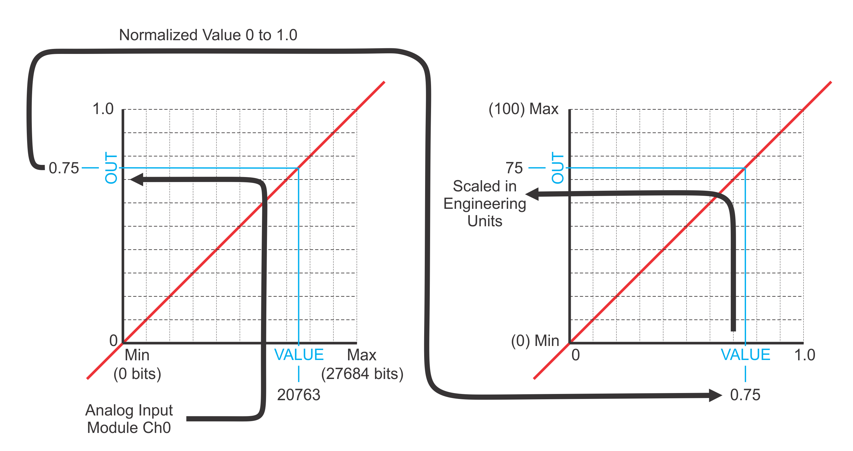
NORM_X and SCALE_X INSTRUCTION
NORM_X
SCALE_X

Slide 20
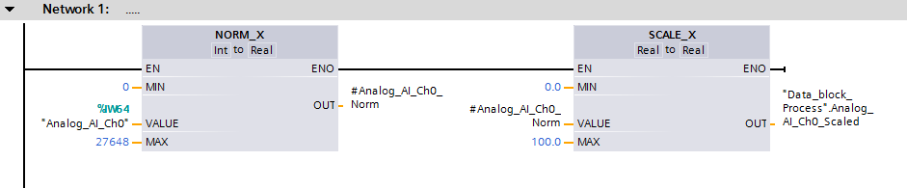
LADDER LOGIC SCALE ANALOG INPUT
The Analog Input module’s bit VALUE as the instruction’s In…

Slide 21
LADDER LOGIC SCALE ANALOG INPUT
…is normalized to the MIN and MAX bit values.

Slide 22
LADDER LOGIC SCALE ANALOG INPUT
Producing an OUT value between 0 and 1.0 as a floating point number.
The linear normalized VALUE is the In to the scaling…

Slide 23
LADDER LOGIC SCALE ANALOG INPUT
…the MIN and MAX process values.

Slide 24
LADDER LOGIC SCALE ANALOG INPUT
Producing a scaled OUT value equivalent the analog bit value.

Slide 25
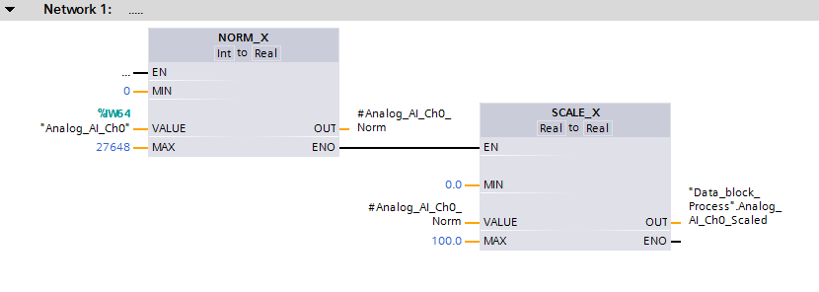
FUNCTION BLOCK SCALE ANALOG INPUT
The Function Block logic is the same as the Ladder Logic except for the minor format differences in instructions.

Slide 26
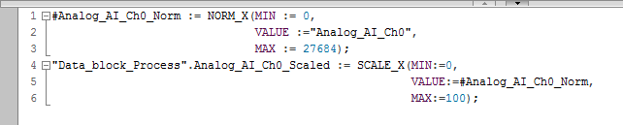
STRUCTURED TEXT SCALE ANALOG INPUT
MINimum bit value.
Normalize Instruction.
OUT normalized value.
In VALUE from Analog Input Ch0.
MAXimum bit Value.
OUT scaled value.
MINimum EU value.
Scale Instruction.
Normalized VALUE.
MAXimum EU value.

Slide 27
STRUCTURED TEXT SCALE ANALOG INPUT

Slide 28
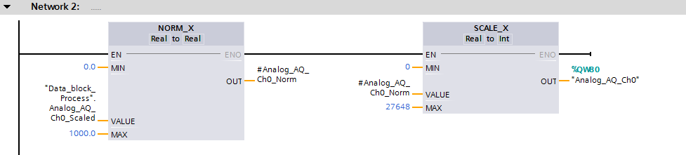
LADDER LOGIC SCALE ANALOG OUTPUT
The process setting is the VALUE to the instruction’s In…

Slide 29
LADDER LOGIC SCALE ANALOG OUTPUT
…the MIN and MAX process values.

Slide 30
LADDER LOGIC SCALE ANALOG OUTPUT
Producing an OUT value between 0 and 1.0 as a floating point number.
The linear normalized VALUE is the In to the scaling…

Slide 31
LADDER LOGIC SCALE ANALOG OUTPUT
…is scaled to the MIN and MAX bit values.

Slide 32
LADDER LOGIC SCALE ANALOG OUTPUT
Producing a scaled analog bit value OUT equivalent the process value.

